Slide 1

BANK ANALYTICS PROJECT
GROUP MEMBERS
Apoorva
Vaibhav
Devata
Harshitha
Abishek

Slide 2

WHAT IS BANK ANALYTICS…?
Bank analytics is the process of collecting, analyzing, and interpreting data from various banking operations (like transactions, loans, and customer activity) to extract actionable insights that guide decision-making and strategy.

Slide 3
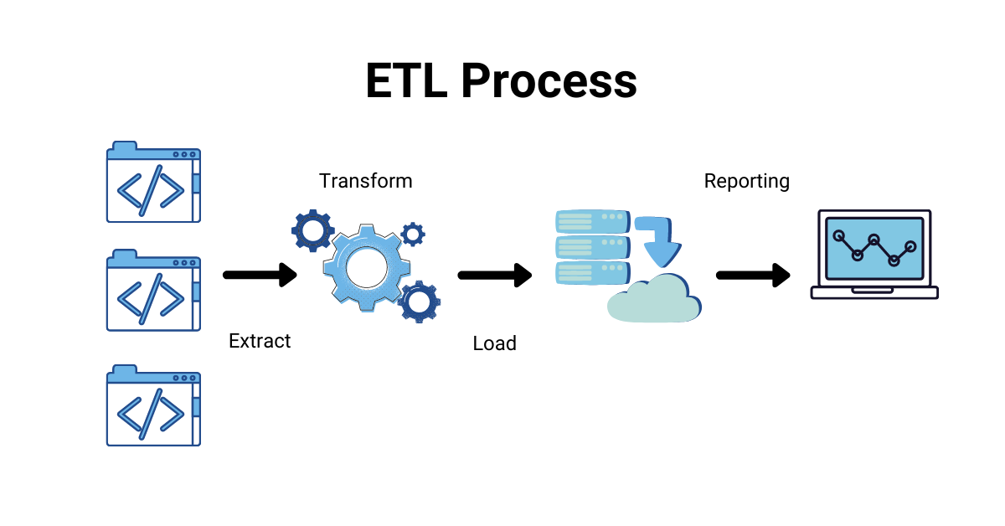
OBJECTIVE OF PROJECT
In this project we have been provided with 2 sets of datasets with .csv file extension consisting of 39k row each.
Data Analyzing, Data Cleaning(Removing of duplicates), Data Visualization & Reporting has been done by using the following tools:
Excel
Power BI
Tableau
MYSQL …to present Insights/Dashboard

Slide 4

KPI’S
Year wise loan amount Stats
Grade and sub grade wise revol_bal
Total Payment for Verified Status Vs Total Payment for Non Verified Status
State wise and month wise loan status
Home ownership Vs last payment date stats

Slide 5
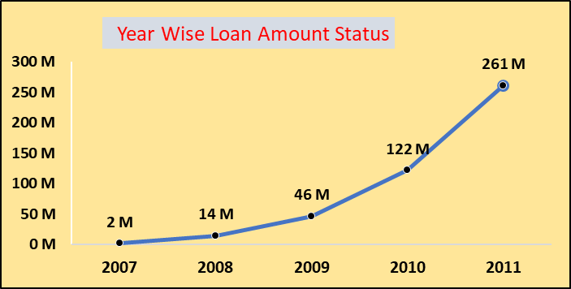
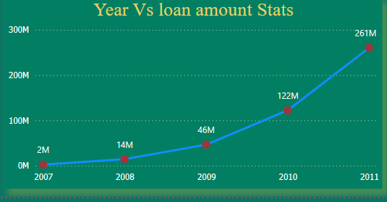
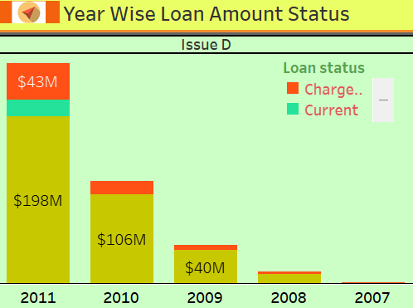
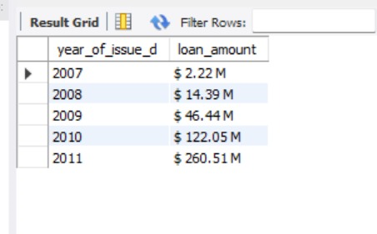
Year wise loan amount Status
In this we have used Line chart and Stacked Bar chart to show the loan amount status year wise.
Starting from 2007 the loan amount is 2M and in the 2011 the loan amount is 261M.
By subtracting the new value to the old value to see the difference 261-2=259M.
So totally there is a 259M increased from 2007 to 2011.
SQL QUERY: select year(issue_d) as year_of_issue_d, concat("$ ", format(round(sum(loan_amnt)/1000000,2),2)," M ")as loan_amount from finance_1 group by year_of_issue_d order by year_of_issue_d;

Slide 6
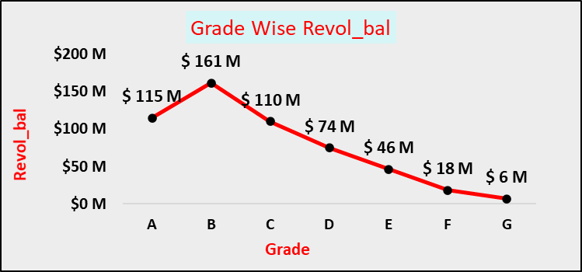
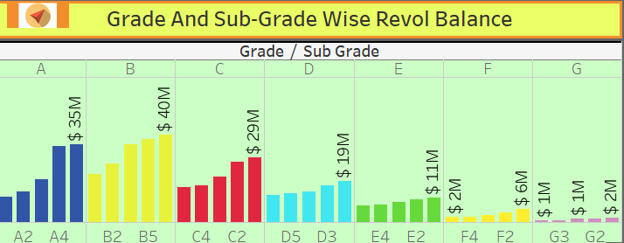
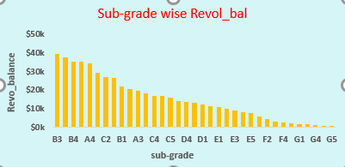
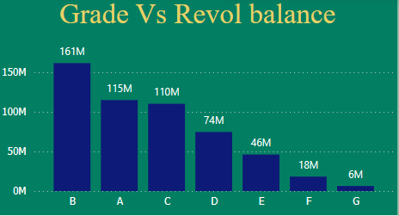
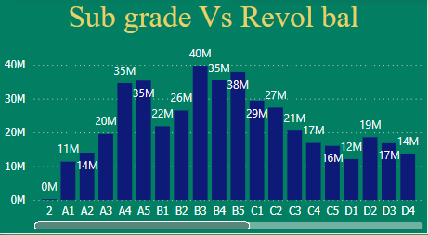
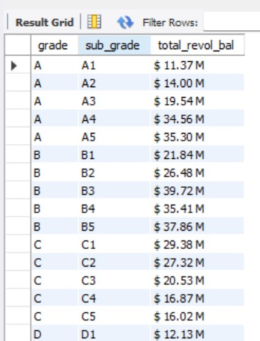
Grade and Sub-Grade Wise Revol_Bal
From this KPI’S we can notice the grade b has high revol_bal of $161M and grade g has low revol_bal of $6M.
Since, the debit income ratio is low when compared to Grade F&H. There is a more intake of loan in Grade B
Sequence:(B>A>C>D>E>F>G)
SQL QUERY: select grade,sub_grade,concat("$ ", format(round(sum(revol_bal)/1000000,2),2)," M ") as total_revol_bal from finance_1 inner join finance_2 on finance_1.id=finance_2.id group by grade, sub_grade order by grade;

Slide 7
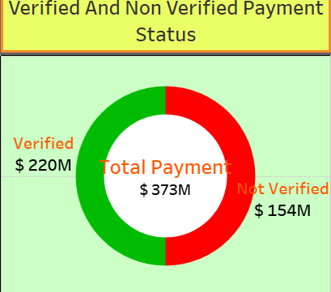
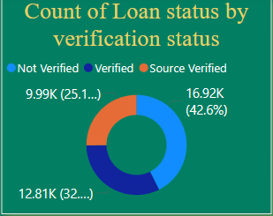
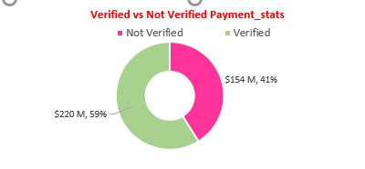
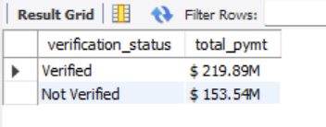
Total Payment for Verified Status & Non Verified Status
A significant portion (59%) of loans are verified, but the presence of unverified loans suggests potential for tightening verification processes.
The total payment of verified & non-verified status is $373M.
SQL QUERY: select verification_status ,concat("$ ", format(round(sum(total_pymnt)/1000000,2),2),"M") as total_pymt from finance_1 inner join finance_2 on finance_1.id=finance_2.id where verification_status in('Verified', 'Not Verified')group by verification_status;

Slide 8
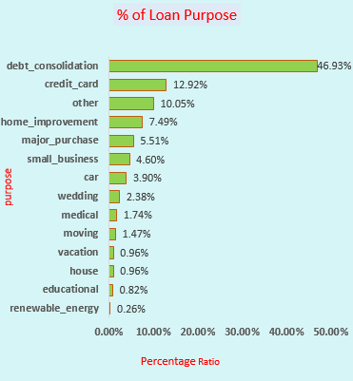
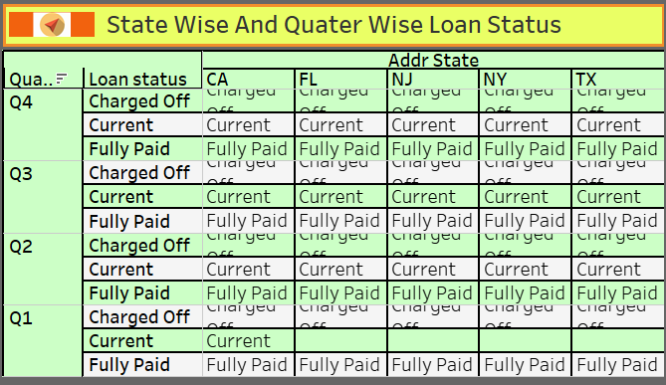
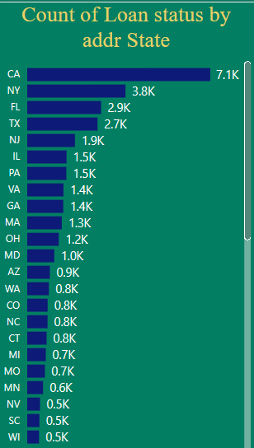
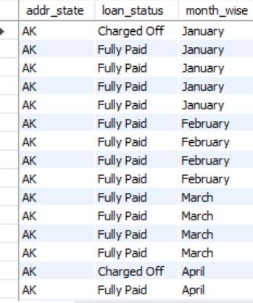
State &Month Wise Loan_Status
The graph shows the % of loan taken based on the purpose.
.the debt_consolidation has highest loan_status compared to renewable_energy.
States with more debt_consolidation has pay more amount.
Nearly 97% of bank customers have fully paid
SQL QUERY: select addr_state, loan_status,monthname(last_credit_pull_d) as month_wise from finance_1 inner join finance_2 on finance_1.id=finance_2.id group by addr_state,last_credit_pull_d,loan_status order by addr_state;

Slide 9
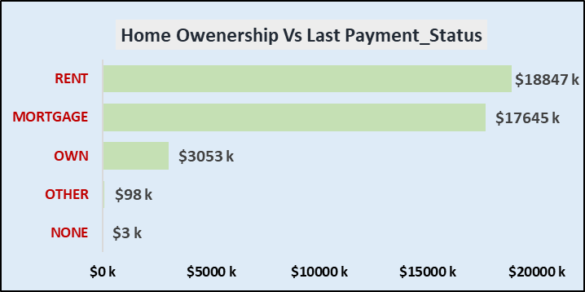
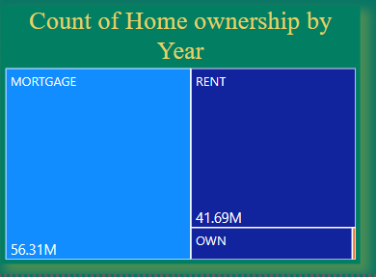
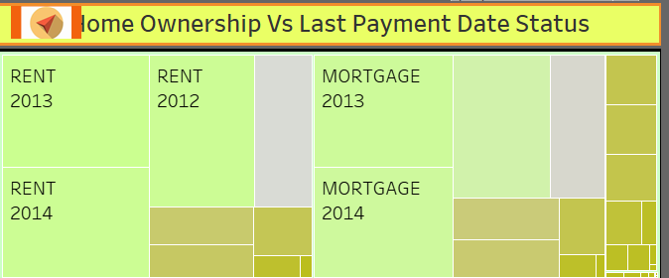
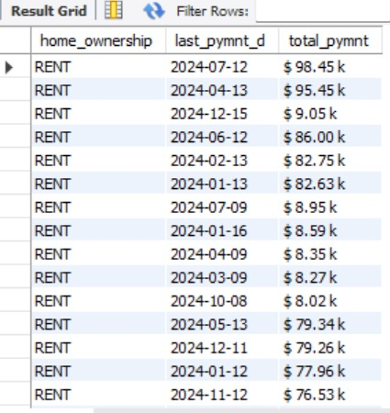
Home ownership Vs last payment date status
The graph shows the Home ownership and the amount paid for each on last payment date.
According to the kpi we can state that Mortage has highest last_payment_amnt by 56.31M.
It concludes that many of the customers are about to repay their loan amount for their particular home ownership.
Many customers has to the pay the loan_amount for their particular home_ownership.
SQL QUERY: select home_ownership,last_pymnt_d,concat("$ ", format(round(sum(last_pymnt_amnt)/10000,2),2)," k") as total_pymnt from finance_1 inner join finance_2 on finance_1.id=finance_2.id group by home_ownership,last_pymnt_d order by home_ownership desc ,total_pymnt desc;

Slide 10

From our side…..

